Slide 1
Mizuho dashboard
6 Nov 2020
Presented by Xiang Shang

Slide 2
Project Background

Slide 3
Involved Parties
This is a collaboration between
PQM
AIOD
Tableau
Users
(SG Mizuho Stakeholders)

Slide 4

Dashboard Tool - Tableau
What's Tableau
“Grand master” of data visualization software
Over 60,000 user accounts across a multitude of industries
Interactive interface with simple drag-and-drop functionality speeds up and simplifies the creation process
Can easily handle large, fast-changing datasets

Slide 5
Why this project
Dashboard Culture
Bringing Dashboard culture easily to BU. Business users and non-IT savvy staff can easily create the dashboards through Tableau
Establishing the eco-system. Synchronizing the current environment; Dashboards can be saved and retrieved in future; User could access the report using their windows ID.
Viewers can more actively participates in the presentation and interact with the dashboards.
Centralized environment and no installation required to view the report. Easy maintenance of production and disaster recovery.

Slide 6
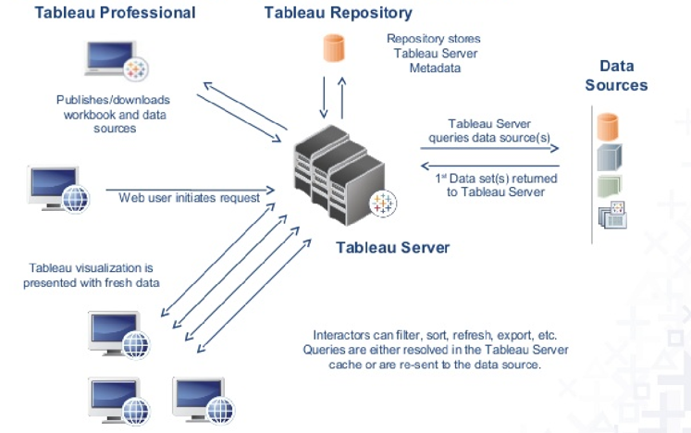
Goal
Deploy Tableau Server to enable collaboration and empower more users to gain insights from the dashboard while ensuring data governance
Centralized environment
Using Active Directory to access i.e. login using own Windows ID
Using web browser, no desktop installation required

Slide 7
Current Usage

Slide 8

Dashboard Tool - Tableau
Tableau is not new to Mizuho
Currently Mizuho have 22 desktop licenses (9 desktop, 13 creator) managed by different departments and having different expiry dates
AOOP/AOAD 7 (Desktop-6 Creator-1)
AOTD 3 (Desktop-3)
RMD 3 (Creator-3)
MRD 4 (Creator-4)
AIOD 5 (Creator-5)
8

Slide 9

Current Usage
Current we have 22 Tableau client license purchased by various department/section (AOAD, AOOP, AOTD, AIOD, MRD and RMD).
AOAD (FCD, CRM and DMS)
They will be using Tableau for MAS 610 reporting purposes. Tableau dashboard display summary of report figures, user is able to drill down into details and to check validation rules that failed.
AOOP (Section Head and PQM)
Productivity Tool Dashboard to check their own staff's productivity. For example, how much transactions they have completed everyday or monthly. Aim to replace the current excel sheets and manual inputs.
RMD
Uses Tableau to analyze Asset and Liability Management (ALM) and Market Risk related information, such as limit usages, balance sheets, PL; then summarize the information into the interactive dashboard.

Slide 10
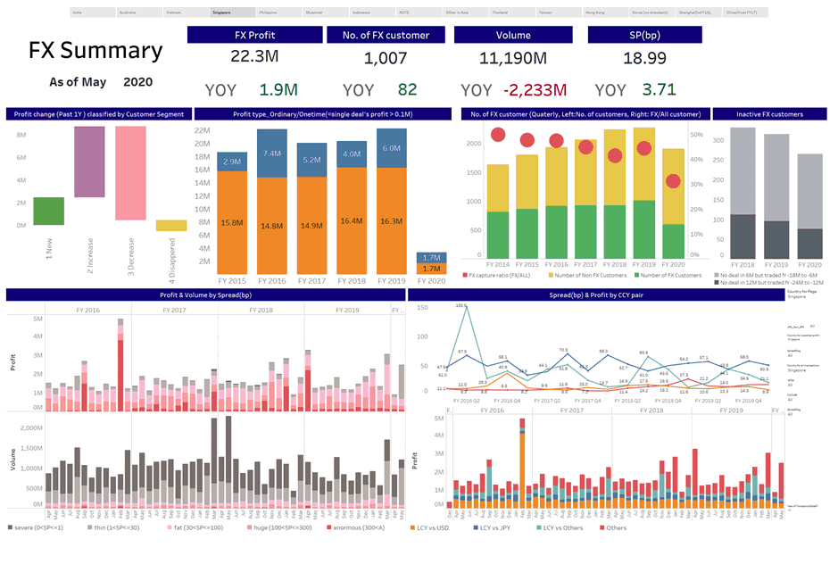
Example from AOTD

Slide 11
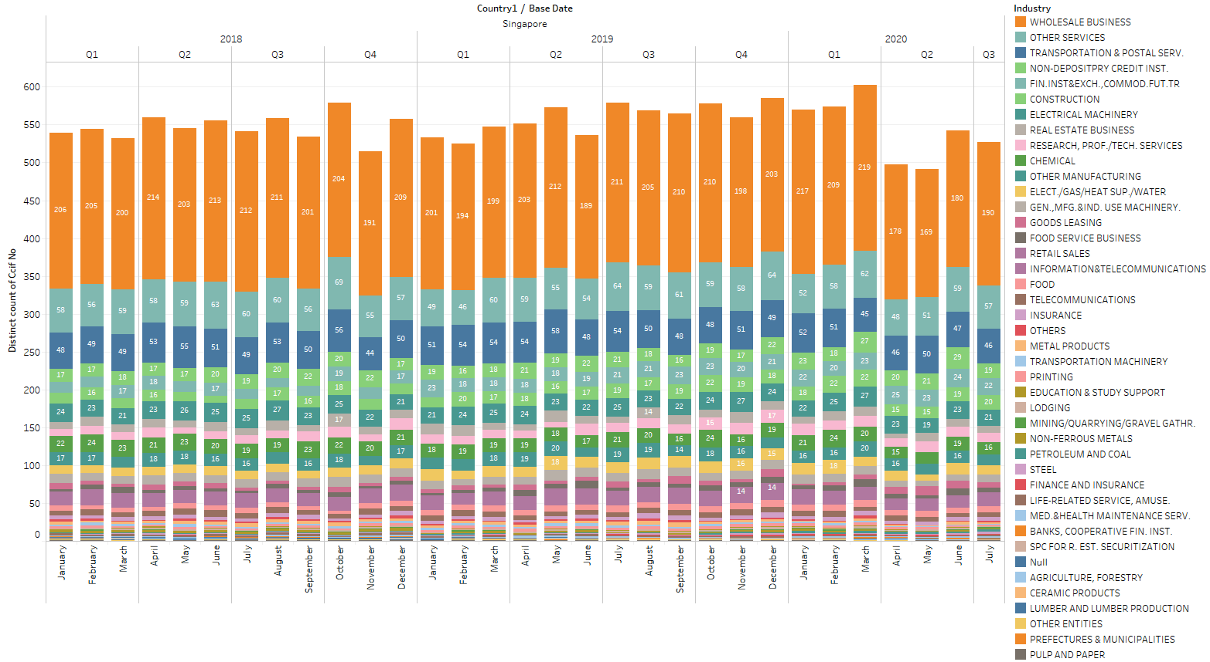
Example from AOTD

Slide 12
Project Development

Slide 13
Server Benefits
Usage
With implementation of server Tableau, we can expand usage more efficiently.
Excel
Excel sheets unable to process huge amount of data and much slower compared to Tableau.
Chart
Better Chart representations of data which is not available in Excel.
Data
Centralized data source to be shared with departments/sections.
Accessibility
No individual installation required.
Cost
No Overall Cost. Use of existing Tableau license and server resource.

Slide 14
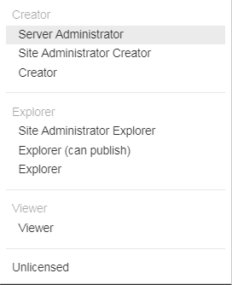
Workshop to understand different Roles and Permissions
1. Tableau Creator - to create and publish data sources 2. Tableau Viewer - to view and interact with trusted content in the server - gives users access to the right data within a governed platform without the exporting and emailing that puts the security of the data at risk 3. Tableau Explorer - can create new workbook using data sources published to Tableau Server - but cannot create new data sources 4. Tableau Server - allows users to publish and retrieve workbooks securely - to centrally manage collaboration, security and performance

Slide 15
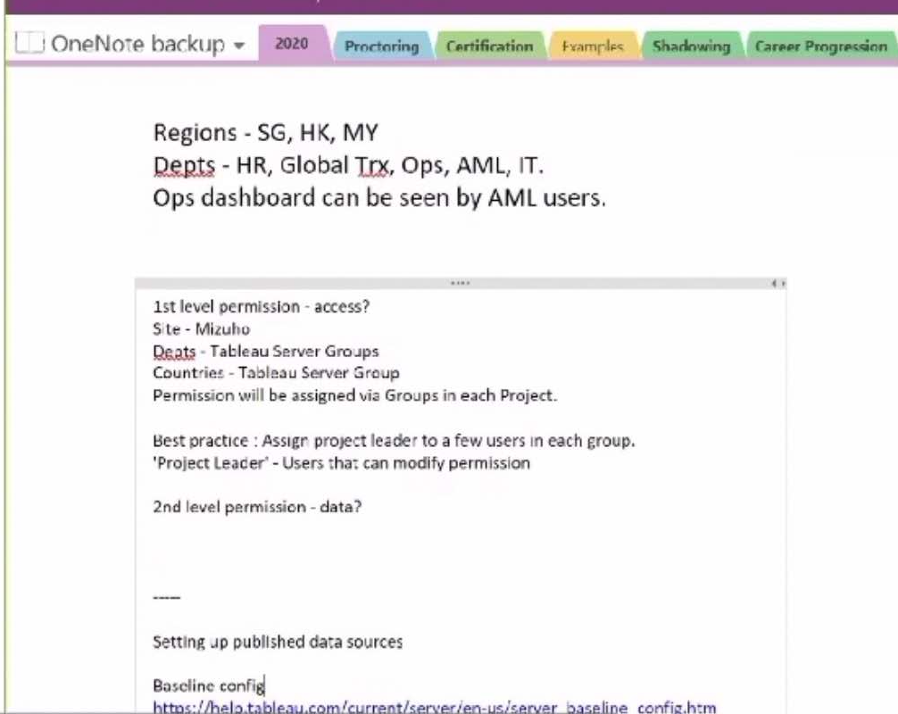


Analyzing the best practice of Roles, Groups and Permissions for Mizuho Scenario
Best Practice
Dashboards
1st level permission: Control of access. Permission will be assigned via Groups in each Project.
2nd level permission: Control of data
Assign project leader to a few users in each group.
(Project leader: Users that can modify permission.)

Slide 16
Preparation
Stakeholders
Software
Collected the license information and current usage from various stakeholders. (RMD, AOTD/planning, MRDD, AOOP & AOAD)
Discussed with stakeholders about project details on July 14
Aligned the expiry date of all licenses from different departments to May 2021
Introduced the concept of different licenses to stakeholders
Obtained input from stakeholders and estimated number of licenses may need.
Obtained installation package with help from Helpdesk and conducted system checking; Necessary ID application was created for installation.
License purchase proposal submitted to AIOD for review. However, due to the bank cutting cost under special situation, additional Creator and Explorer licenses proposal is not approved.
Troubleshooting of the Tableau Server issues. Raised several issue tickets to Tableau and get support from their Australia and Singapore Branch

Slide 17
Active Directory and Internal Setup
Trial Installation
Trial server and testing licenses for pilot testing.
Active Directory
Applications
Ringi Application done by SOA
Pega Application circulate between AOOPD and AIOD.
Linking Tableau Server with Active Directory as Identity Store need to have fresh installation.
Active Directory (AD) allow users to login through their windows ID. (Like Pega)
CyberArk application for the ID
After discussion, SOA will take system ownership.
Notes:
CyberArk, ID control system

Slide 18
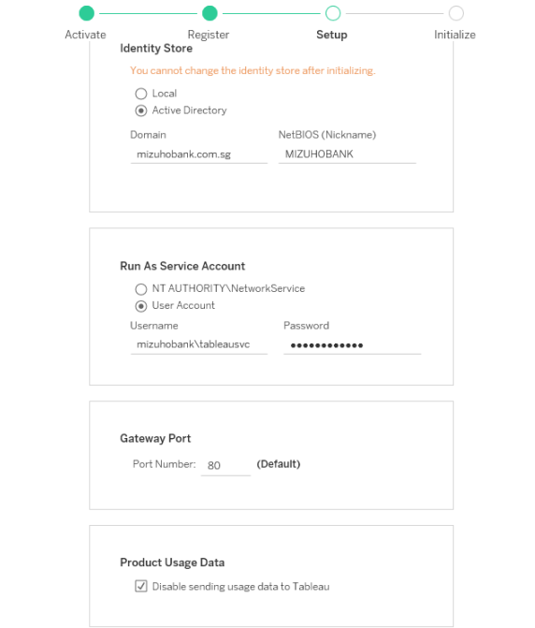
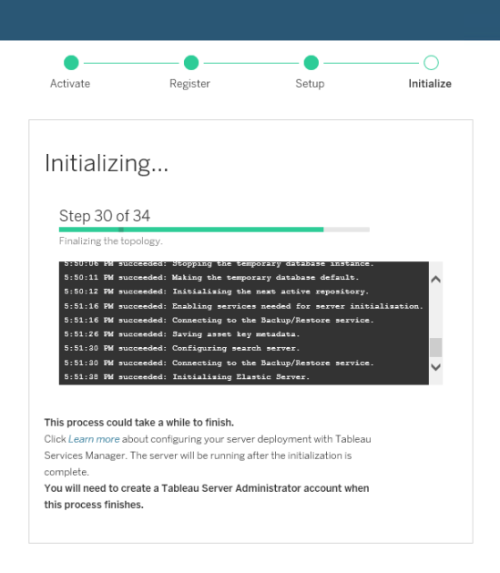
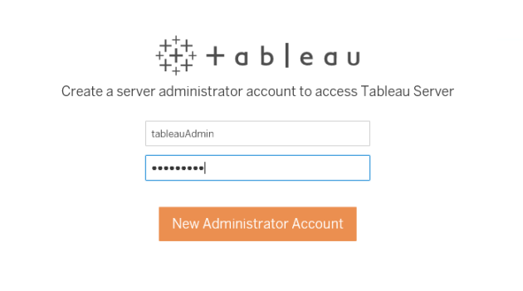
Installation
Configuration
Installation
Create account

Slide 19
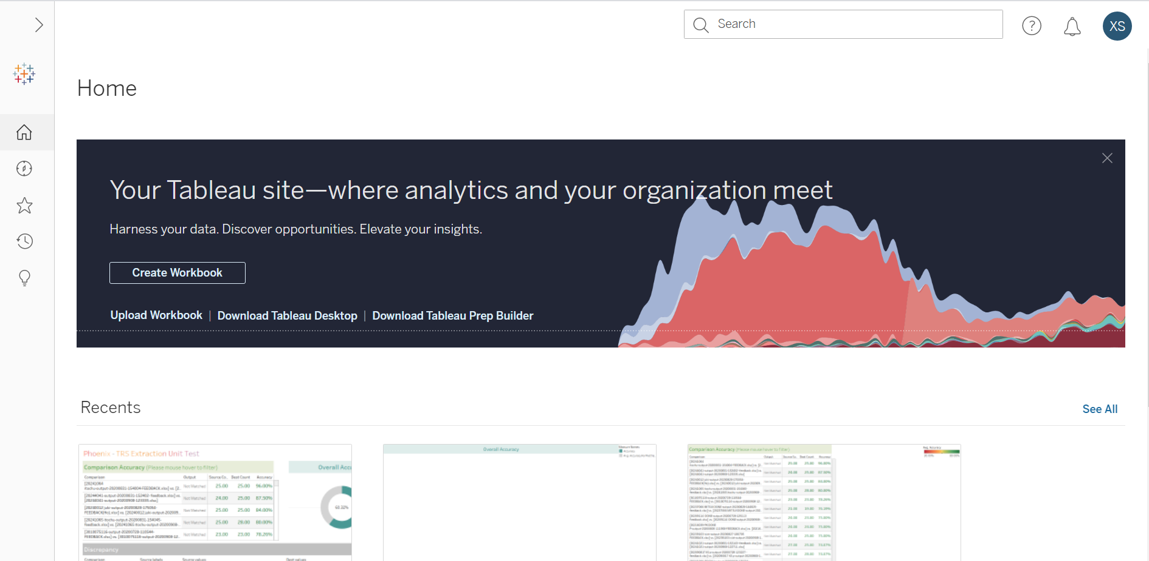
Server
http://dasvtableau01

Slide 20
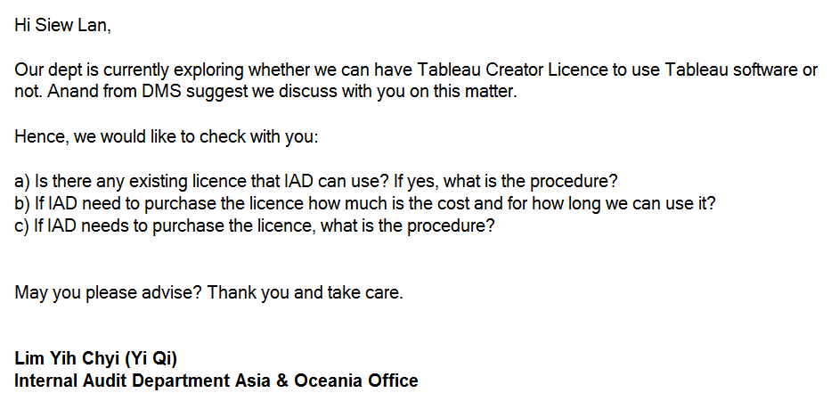
Positive Response

Slide 21


Next Steps
Training
Tableau
Tableau Virtual Bootcamp – 13 Jul to 24 Jul
Tableau online eLearning
Innovation Team
Workshops
For users who need to create new workbooks, dashboards (Creators)
For users who need to view and interact with published workbooks, dashboards (Viewers)
Backup and Disaster Recovery
AIOD

Slide 22
Key Takeaways

Slide 23



Key Takeaways
Project Managements
Coordination
Steep Learning Curve
Multitasking
Finding solutions from various resources to solve issues
Compromise
Understanding the needs and objectives of users
People and Communications
Products
Failures and setbacks

Slide 24
Appendix

Slide 25
Tableau Public: https://public.tableau.com/profile/xiang.shang#!/vizhome/MizuhoinCovid19/Sheet1
US election: https://www.bloomberg.com/graphics/2020-us-election-results

